Slide 1
Workshop on Arty A7 FPGA board using Verilog
Jayaraj V S
Assistant professor
Department of ECE
SBCE

Slide 2
Overview of the workshop
Introduction to Verilog HDL
Vivado Design flow
Simulations using Vivado
Vivado FPGA programming
Introducing Micro Blaze which is Xilinx’s soft processor core
Introducing Xilinx SDK for developing C projects on FPGA
Creating a custom IP block in Vivado

Slide 3
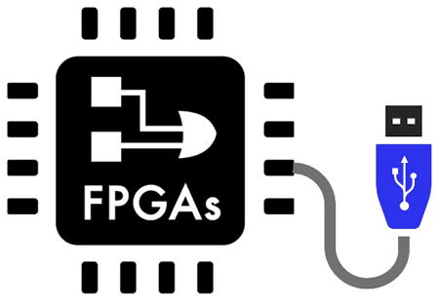
What is an FPGA?
A Field-Programmable Gate Array is an integrated circuit silicon chip which has array of logic gates, and this array can be programmed i.e., the user can overwrite the existing configurations with its new defined configurations and can create their own digital circuit on it.
The FPGAs can also be considered as blank slate.
FPGAs do nothing by itself whereas it is up to designers to create a configuration file often called a bit file for the FPGA. The FPGA will behave like the digital circuit once it is loaded with a bit file.

Slide 4
WHAT IS A MICROCONTROLLER?
A microcontroller (MCU) is basically a small computer.
It has all the same elements as other computers, including a central processing unit (CPU), some random-access memory (RAM) and input and output devices.
Unlike a desktop computer, which can run thousands of different programs, a microcontroller is a special-purpose device that performs one program.

Slide 5
Comparison table: FPGA vs Microcontroller
Criteria | FPGA | Microcontroller
Flexibility | Hardware and firmware reprogrammable. Superior customization. | Reprogramming is possible in firmware only
Programming Firmware | Comparatively complex | Simple programming
Tools | No portability across tools. | Open source tools available
Cost | Costly | Cost effective
Processing power/speed | Higher | Lower

Slide 6
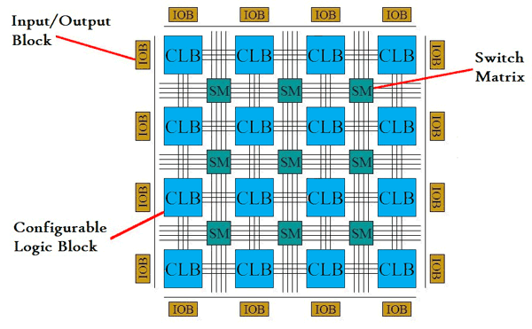
FPGA Architecture
The FPGA is built with mainly three major blocks such as Configurable Logic Block (CLB), I/O Blocks or Pads and Switch Matrix/ Interconnection Wires.
Configurable Logic Blocks — which implement logic functions.
I/O Blocks or Pads— which connect with external components.
Switch Matrix/Interconnection Wires —Switch Matrix is used in FPGA to connect the long and short interconnection wires together in flexible combination. It also contains the transistors to turn on/off connections between different lines.

Slide 7
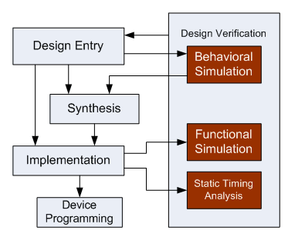
FPGA architectural design flow
FPGA architectural design flow comprises of
Design entry
Logic synthesis
Design implementation
Device programming
Design verification
However, the exact steps vary with manufactures.

Slide 8
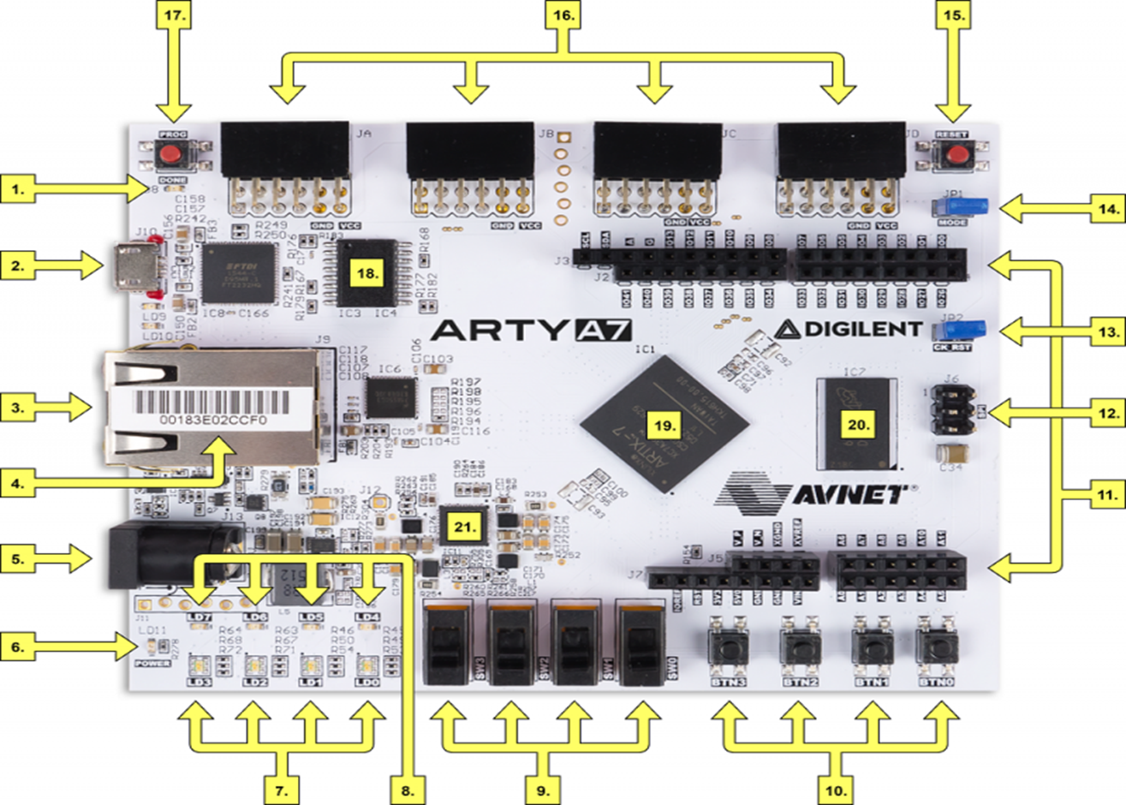
Arty A7 FPGA

Slide 9
Callout | Description | Callout | Description | Callout | Description
1 | FPGA programming DONE LED | 8 | User RGB LEDs | 15 | chipKIT processor reset
2 | Shared USB JTAG / UART port | 9 | User slide switches | 16 | Pmod connectors
3 | Ethernet connector | 10 | User push buttons | 17 | FPGA programming reset button
4 | MAC address sticker | 11 | Arduino/chipKIT shield connectors | 18 | SPI flash memory
5 | Power jack for optional external supply | 12 | Arduino/chipKIT shield SPI connector | 19 | Artix FPGA
6 | Power good LED | 13 | chipKIT processor reset jumper | 20 | Micron DDR3 memory
7 | User LEDs | 14 | FPGA programming mode | 21 | Dialog Semiconductor DA9062 power supply

Slide 10
What is Vivado?
Vivado Design Suite is a software suite produced by Xilinx for synthesis and analysis of hardware description language (HDL) designs, superseding Xilinx ISE with additional features for system on a chip(SoC) development and high-level synthesis.
https://www.xilinx.com/support/download.html

Slide 11
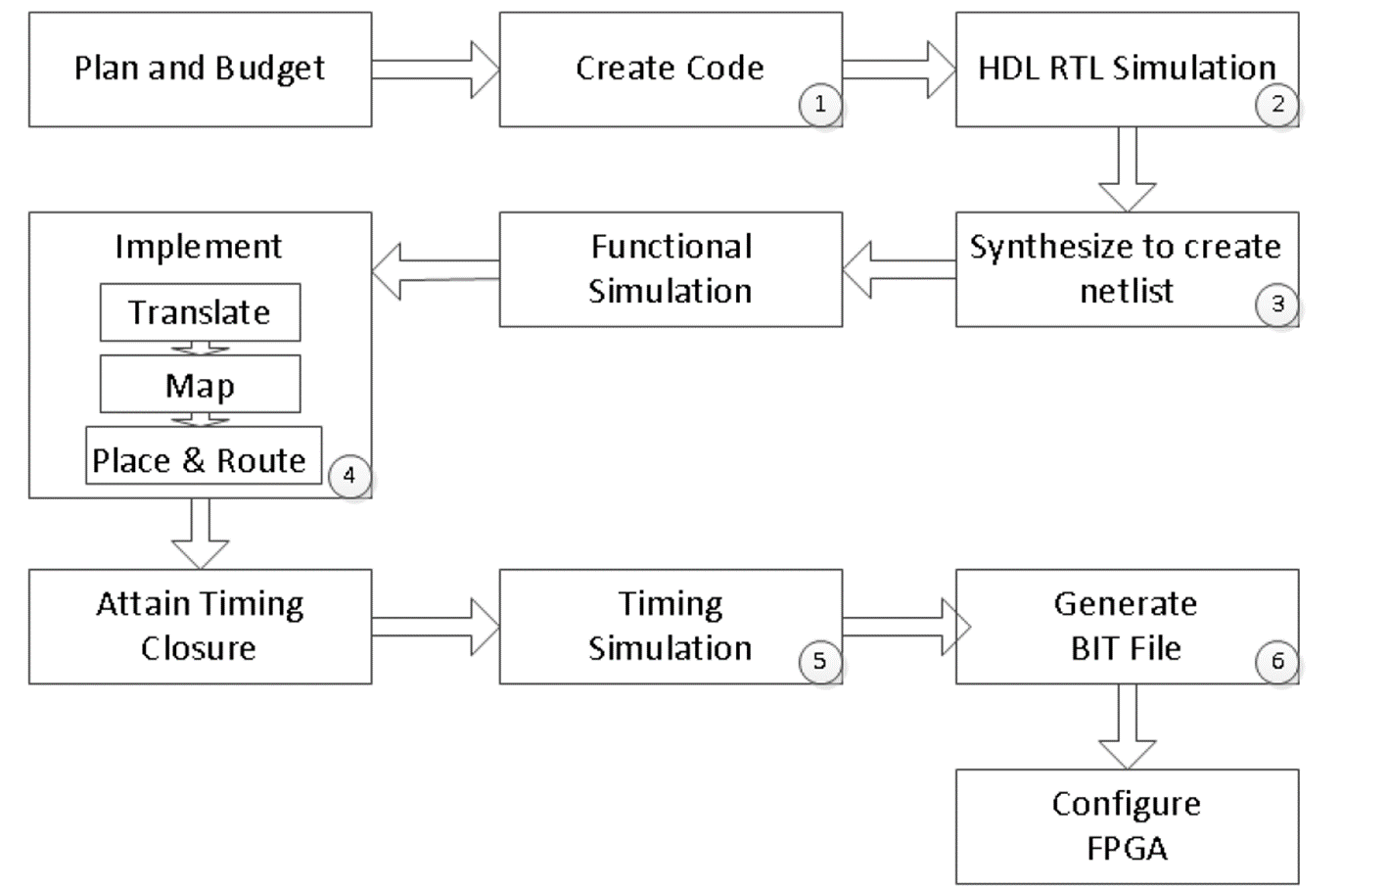
Vivado Design flow

Slide 12
Introduction to Verilog using vivado

Slide 13
What is Verilog?
Verilog is a HARDWARE DESCRIPTION LANGUAGE (HDL), which is used to describe a digital system such as a network switch or a microprocessor or a memory a flip-flop.
Verilog was developed to simplify the process and make the HDL more robust and flexible. Today, Verilog is the most popular HDL used and practiced throughout the semiconductor industry.

Slide 14
Types of Verilog coding
Verilog code can be described in three model formats:
Gate level modelling:
Designing circuits using basic logic gates is known as gate-level modeling.
A digital circuit is implemented using logic gates and interconnections between these gates.
The primitives (The most basic commands of a language) defined in Verilog have been set keeping the user requirements in mind making it easy to design bigger blocks.
For example, for implementing AND gate or logic, the primitive is simply and(Out, A, B).

Slide 15
Types of Verilog coding continued..
Dataflow modelling :
Dataflow modeling makes use of the functions that define the working of the circuit instead of its gate structure.
The designer must bear in mind how data flows within the design.
Dataflow modeling has become a well-liked design approach, as logic synthesis tools became sophisticated.
This approach allows the designer to focus on optimizing the circuit in terms of the flow of data.
Example: assign out = a & b;

Slide 16
Types of Verilog coding continued..
Behavioural Modelling :
The behavioral modeling style is a higher abstraction in the entire saga of Verilog programming.
By higher abstraction, what is meant is that the designer only needs to know the algorithm of the circuit to code it.
Hence, this modeling style is also occasionally referred to as an algorithmic modeling style.
The designer does not need to know the gate-level design of the circuit.

Slide 17
Lets begin Simulation with Vivado

Slide 18

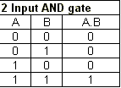
AND Gate Implementation

Slide 19
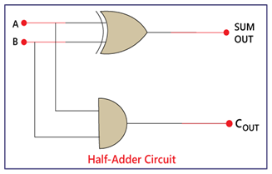
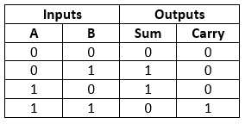
Half adder Implementation

Slide 20
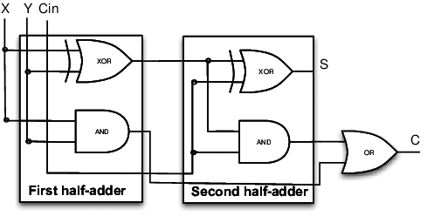
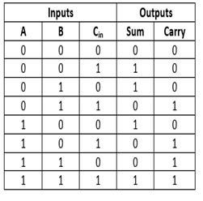
Full adder Implementation

Slide 21
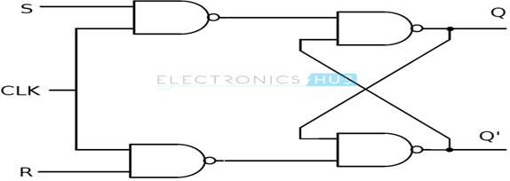
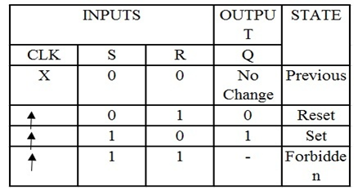
SR Flip Flop Implementation

Slide 22
JK Flip Flop Implementation

Slide 23
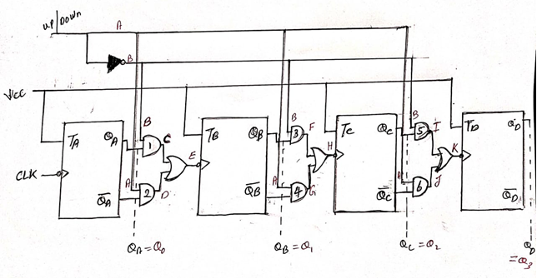
4-bit up down ripple counter using T-flip flops Implementation

